Slide 1
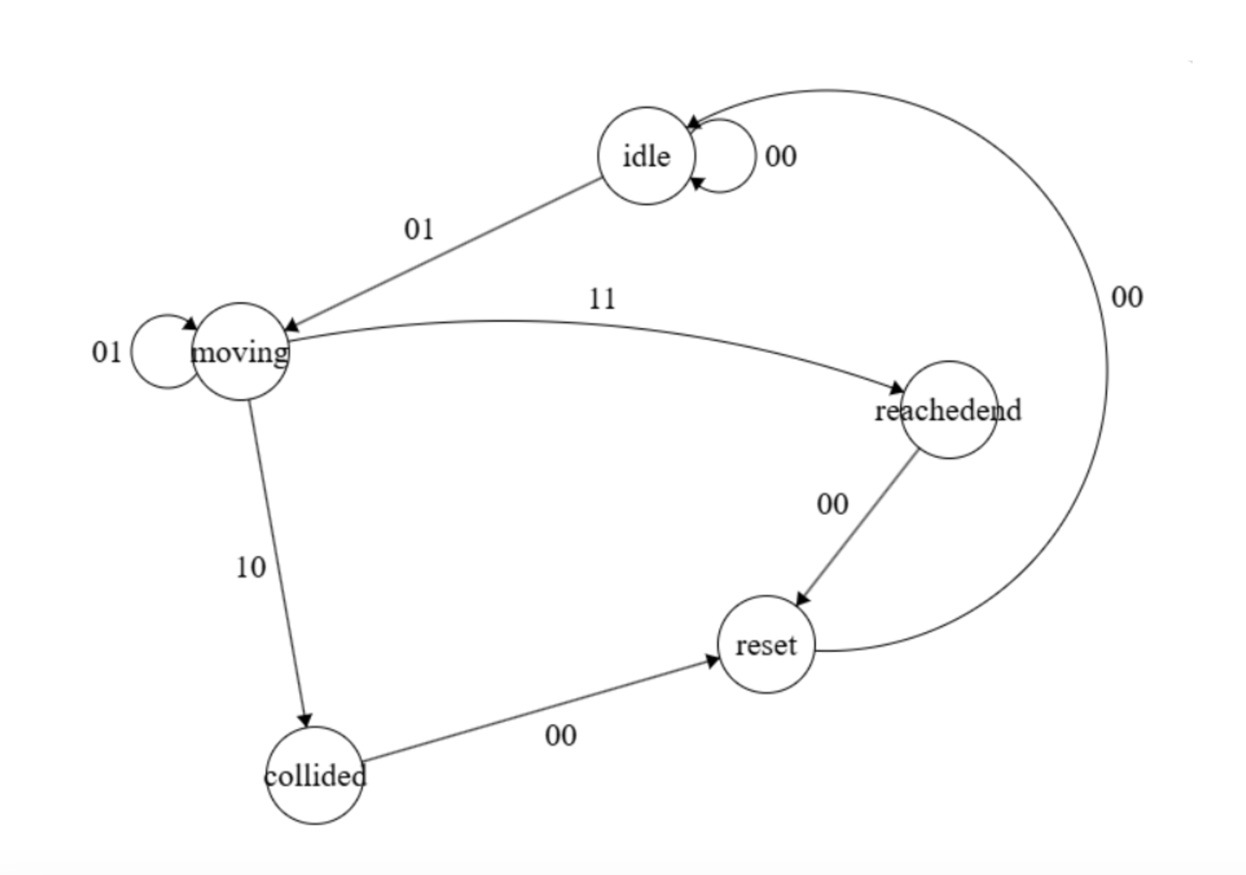
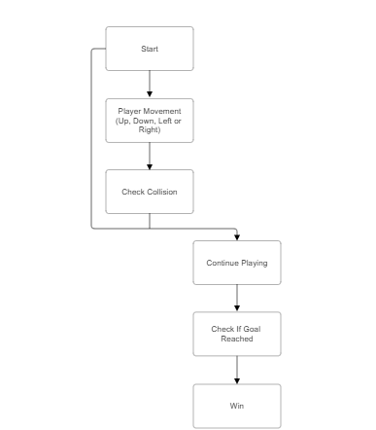
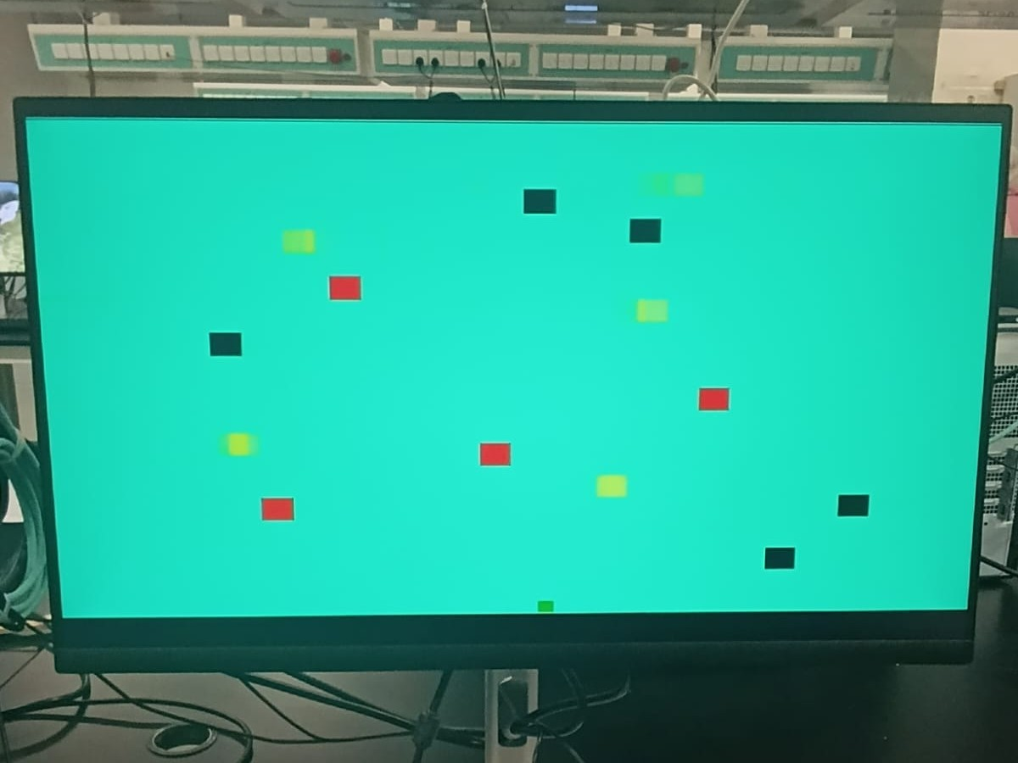
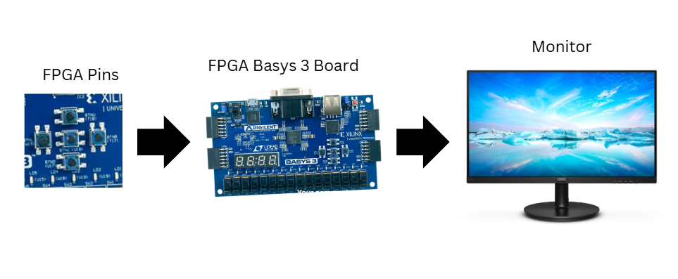
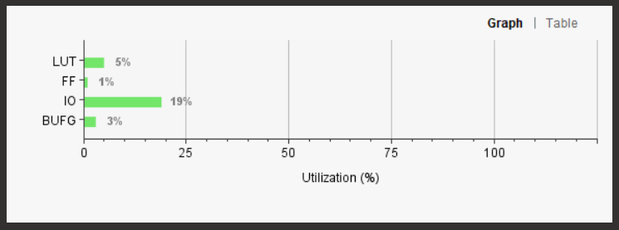
FROGGER NAME Jibran Sajjid , Ahmed Asif , Huzefa Soni , Fowzi Ali
Introduction
This project implements a Frogger game on the Basys 3 FPGA board using a Mealy finite state machine (FSM). The game is controlled through the input pins of the board, allowing the user to navigate the frog across the map and avoid obstacles. The objective is to move the frog from the bottom of the screen to the top, while avoiding various moving and stationary obstacles. To win, the player must reach the top of the screen without colliding with any of the obstacles.

